Slide 1
Land Use Land Cover using deep learning techniques
Dr. Swati Jain,
Associate Professor,
Computer Science and Engineering Dept.,
Institute of Technology,
Nirma University,
Ahmedabad
Dr. Preeti Kathirita
Associate Professor,
Computer Science and Engineering Dept.,
Institute of Technology,
Nirma University,
Ahmedabad

Slide 2
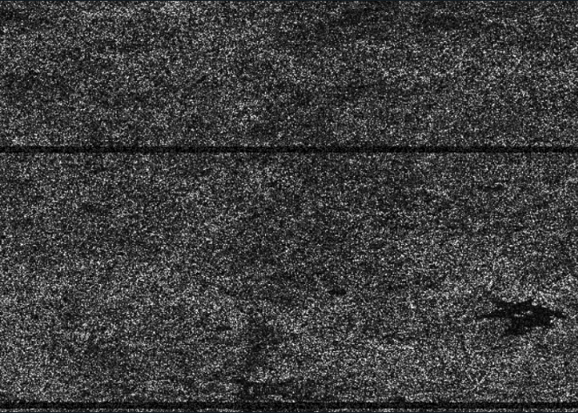
Image of SAR Raw Data

Slide 3
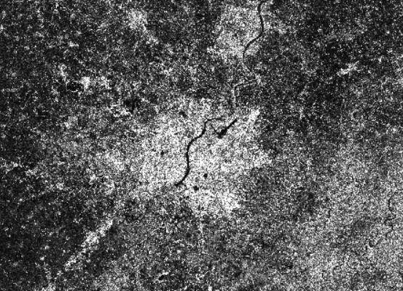
Image after performing all the preprocessing steps

Slide 4
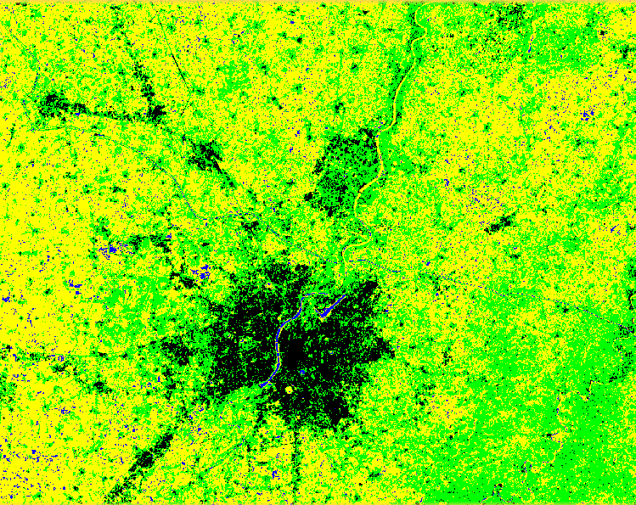
Image after supervised classification using random forest classifier

Slide 5
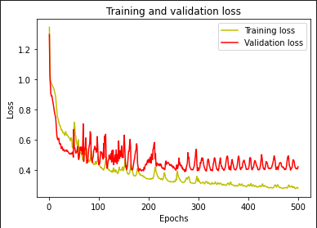
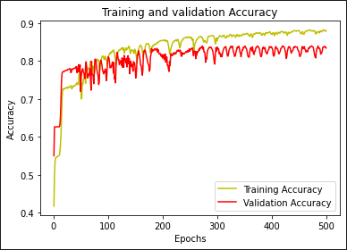
Curves for validation accuracy and loss

Slide 6
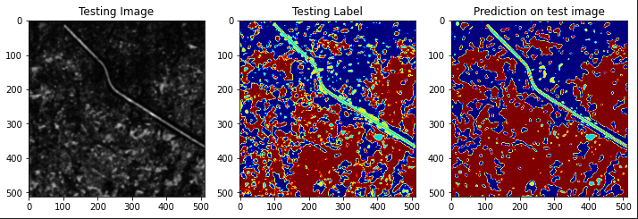
Predicted Image for a certain patch image

